Slide 1
Early Human Experience with the Trans-Septal Saturn TMVR System
Torsten Vahl, MD
Columbia University Irving Medical Center/ NYP Hospital
Paolo Denti, MD, Lauren S. Ranard, MD, Stefano Stella, MD, Giedrius Davidavičius, MD, Agnė Drąsutienė, MD, Bajoras Vilhelmas, MD, Teona Zirakashvili, MD, Tamaz Shaburishvili, MD
on behalf of the CASSINI investigators

Slide 2
Disclosure of Relevant Financial Relationships
Within the prior 24 months, I have had a financial relationship with a company producing, marketing, selling, re-selling, or distributing healthcare products used by or on patients:
Nature of Financial Relationship | Ineligible Company
Grant/Research Support | Edwards Lifesciences, Boston Scientific, Medtronic, JenaValve
Consultant Fees/Honoraria | 4C Medical, Abbott, Innovheart, Philips
Individual Stock(s)/Stock Options | NA
Royalties/Patent Beneficiary | NA
Executive Role/Ownership Interest | NA
Other Financial Benefit | NA
All relevant financial relationships have been mitigated.
Faculty disclosure information can be found on the app

Slide 3
SATURN TMVR
The Saturn TMVR is a two component system with an interlocked design which includes:
an annular structure, intended to be positioned behind the native mitral leaflets, to reshape and stabilize the MV annulus
a central valve, intended to be expanded inside the mitral orifice
a set of connecting arms, to provide mechanical bond between the valve and the annular structure
+
=
annular structure
central valve
Saturn TMVR
connecting arms
CAUTION Investigational device. Limited by Federal (or United States) law to investigational use.
Notes:
2

Slide 4
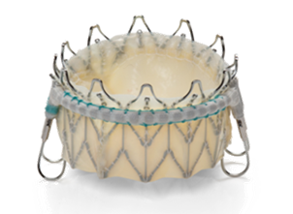
InnovHeart’s SATURN TMVR CASSINI Studies
After completing the SATURN TA study of 5 subjects with 2-year follow-up, InnovHeart initiated the TS CASSINI-EU study (N=30)
The CASSINI-US study (N=15) is expected to start by end of 2025

Slide 5
CASSINI-EU Study
Study Overview
Purpose | To evaluate feasibility, safety, and performance of the SATURN TS TMVR System for the treatment of moderate-to-severe or severe, symptomatic mitral regurgitation through a transcatheter, trans-septal approach
Trial Design | A prospective, multi-center, single-arm, non-blinded feasibility study.
Scope | Up to 30 subjects treated at 10 sites in Europe (Lithuania, Poland, Georgia, Italy and UK)
Primary Endpoints | Technical Endpoint: Technical implant success at exit from procedure room Safety Endpoint: Freedom from device-related, major adverse events at 30D Performance Endpoint: Reduction of MR Grade to ≤ 1+ at 30D
Secondary Endpoints | Reduction of MR grade compared to baseline, and freedom from associated hemolysis at 30D, 1Y and annually to 5Yrs.
Governance | Subject Screening Committee Echo Core Laboratory CT Core Laboratory Clinical Events Committee Data Safety Monitoring Board
Notes:
4

Slide 6
CASSINI-EU STUDY - Key Inclusion and Exclusion Criteria
Inclusion Criteria | 18 Years of age or older​ Symptomatic, moderate-severe or severe functional or mixed mitral regurgitation (≥ Grade 3+)​ NYHA functional Class ≥ II High risk for open-heart mitral valve surgery, as determined by the Heart Team Willing and able to provide informed consent
Exclusion Criteria | Exclusively primary/degenerative mitral regurgitation eGFR <30mL/min/m² LVEF <30% Severe MAC, severe stenosis, vegetation or mass Prior mitral valve repair or replacement ​Severe aortic regurgitation or stenosis Prior surgical, mechanical or transcatheter aortic valve implant Severe tricuspid regurgitation Severe RV dysfunction Inadequately treated for cardiac condition (e.g. CAD, LVD, MR, or HF) Contraindications for TEE imaging Active systemic infection or endocarditis within 3M of procedure Life expectancy <1 year due to non-cardiac conditions
Notes:
5

Slide 7
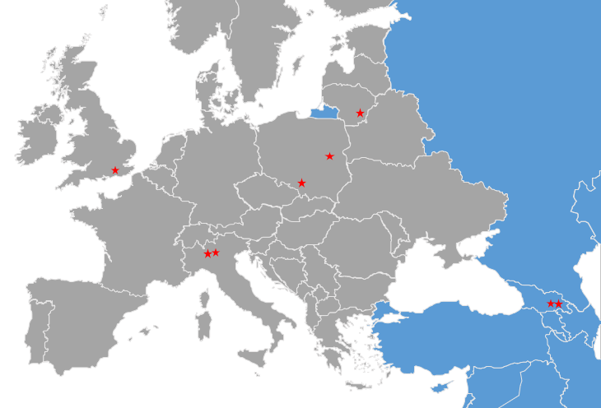
CASSINI-EU STUDY
Sites​​
Vilnius, Lithuania​​
Warsaw, Poland​​
Tbilisi, Georgia​​ (x2)
Katowice, Poland​​
Milan, Italy (x2)​​
Brighton, UK ​​
Notes:
6

Slide 8
CAS 001-001 – Preoperative echocardiography
Severe MR – Mixed type II (predominant) and type IIIb, with A2-A1 prolapse and flail
Notes:
7

Slide 9
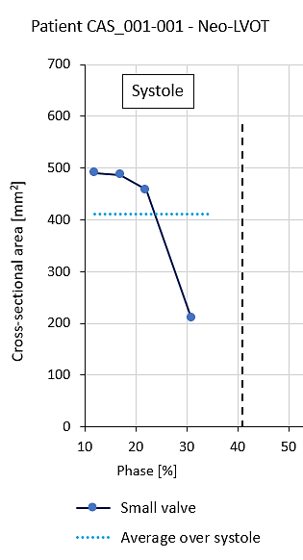
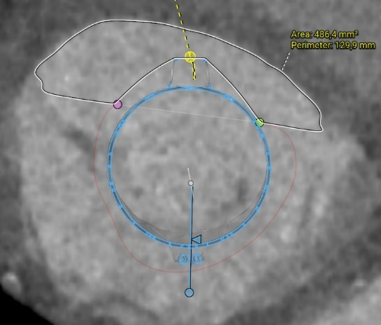
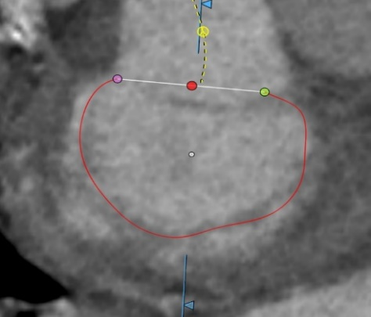
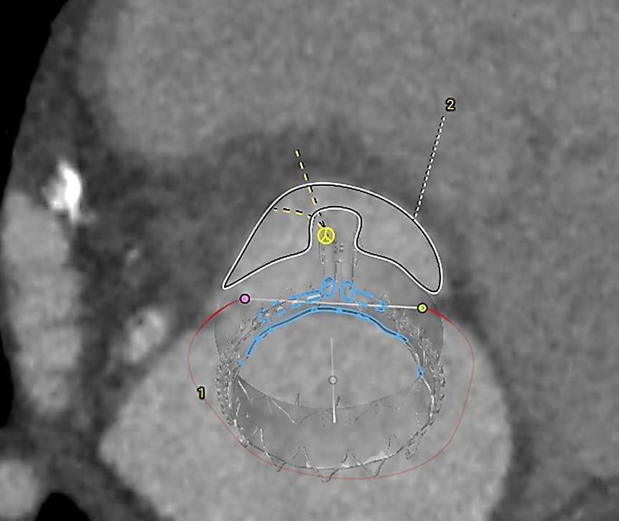
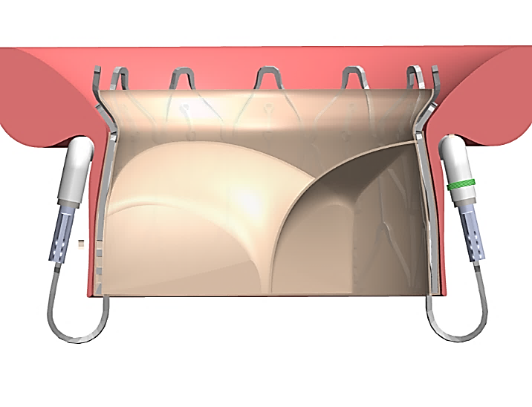
CAS 001-001 – Preoperative planning
 |  | ES | ED
D perimeter | mm | 116.7 | 117.8
P Diameter | mm | 37.1 | 37.5
A-P | mm | 31.4 | 29.2
C-C | mm | 37.5 | 40.3
Neo-LVOT estimate: 490.4 mm²
Early-Systole
28
Neo-LVOT estimate: 209.7 mm²
13
End-Systole
Annulus dimensions compatible with Saturn Small Size (28mm)
No risk of LVOTO
Notes:
8

Slide 10
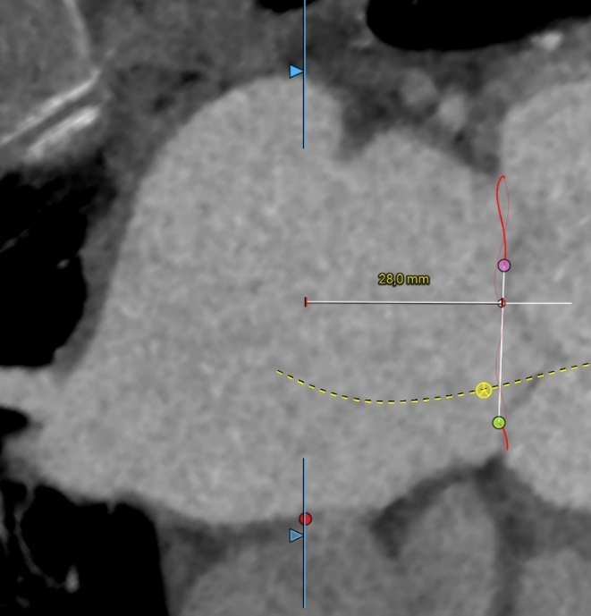
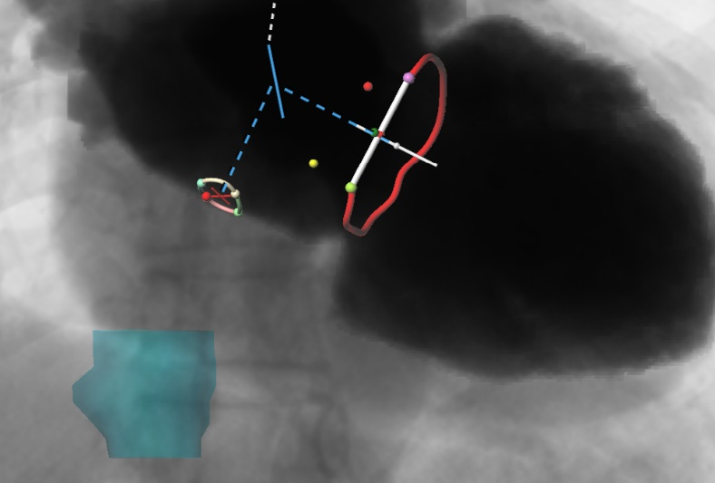
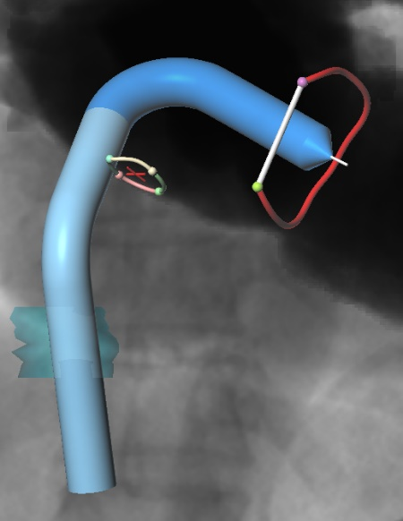
CAS 001-001 – Preoperative planning
LA
LA
LV
RA
Fossa Ovalis
IVC
Fossa Ovalis Upper Rim |  | Height
End Systole | cm | 2.8
End Diastole | cm | 2.9
RA
Small LA (height = 55mm) – Expected TSP height < 3 cm
Notes:
9

Slide 11
CAS 001-001 – Procedure
Insert Delivery System and position GWDS in MV
Create Medial and Lateral Cable Loops
Introduce Annular Segments
Exchange GWDS for VDS and position VDS in MV
Connect Valve to Annular Segments
Withdraw Cables from System
Position & deploy Implant and withdraw DS
Notes:
10

Slide 12
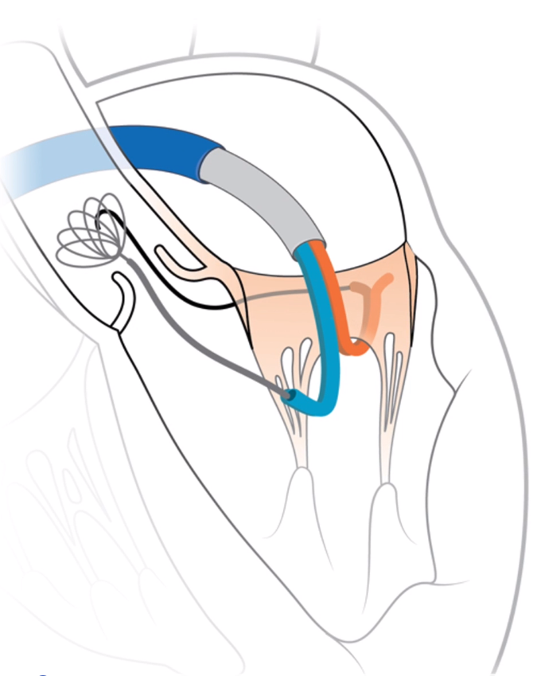
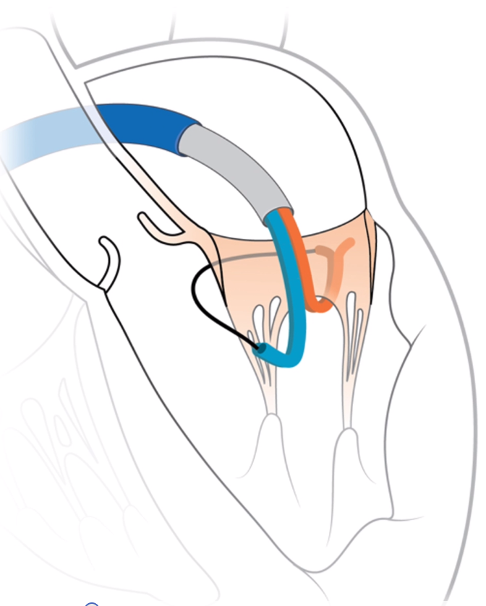
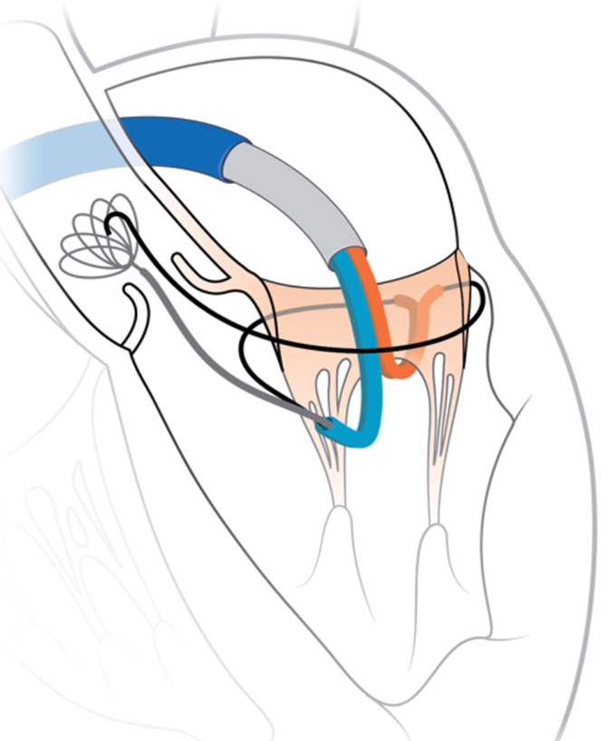
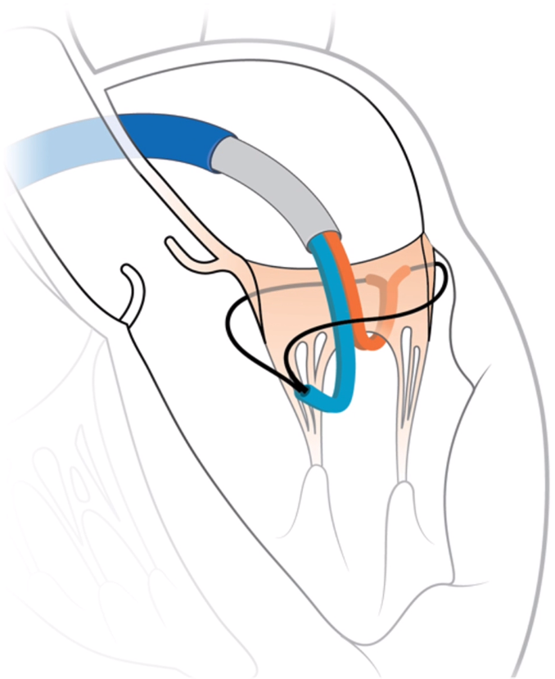
CAS 001-001 – Procedure
Two standard guidewires are inserted behind leaflets to embrace the native mitral valve
Notes:
11

Slide 13
CAS 001-001 – Procedure
Annular segments are introduced over each wire and positioned behind the leaflets
Notes:
12

Slide 14
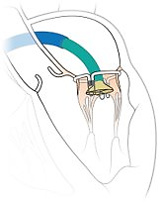
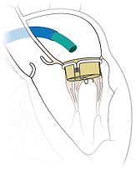
CAS 001-001 – Procedure
The central valve is connected to the annular segments and deployed, capturing the native leaflets between components
Notes:
13

Slide 15
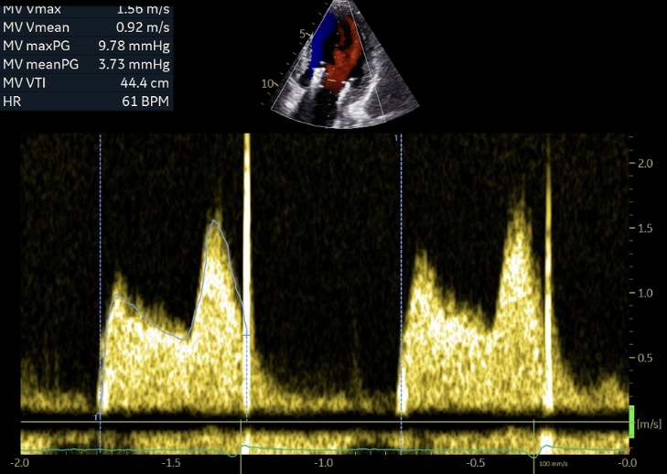
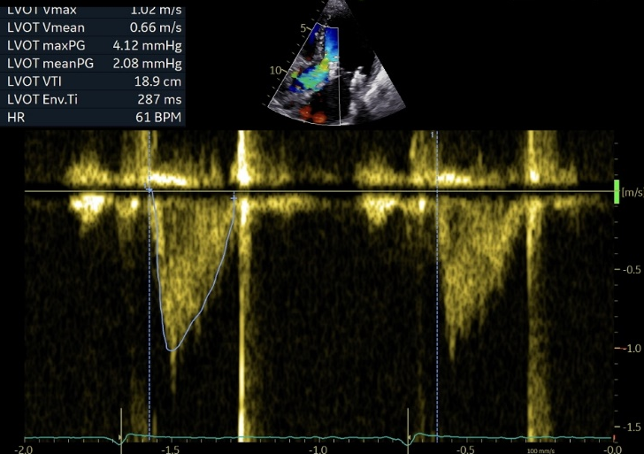
CAS 001-001 – 1 Year follow-up
MV Mean gradient 3.7 mmHg
LVOT Mean gradient
2.1 mmHg
Notes:
14

Slide 16
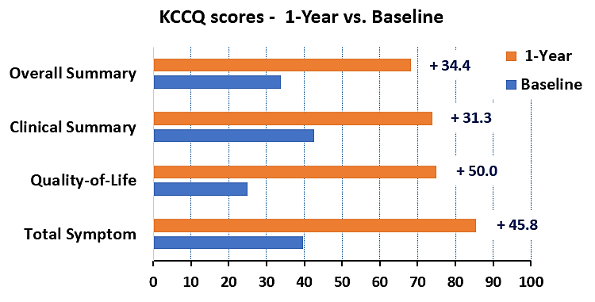
CAS 001-001 – 1 Year follow-up
No MR at any follow-up (1M, 3M, 6M, 1Y)
No LVOT gradient
No ASD closure
Improved 6MWT (Baseline = 150m → 1 Year = 290m)
Improved KCCQ Scores
Notes:
15

Slide 17
Conclusions
The transseptal SATURN system offers a novel solution for MR reduction and annular stabilization.
The SATURN TMVR bioprosthesis has several unique advantages including:
Ability to resize the mitral annulus
Low profile (13 mm) in the LV, reducing the risk of LVOT obstruction
Anterior connecting arm immobilizes the anterior leaflet preventing SAM
The safety and efficacy of the transseptal SATURN TMVR is now being evaluated in the CASSINI-EU EFS study
1-Year follow-up has been achieved for the first patient, confirming safety and performance in the mid term
Notes:
16

